Slide 1
AIR QUALITY MONITORING

Slide 2
COMPONENTS USED IN AIR QUALITY MONITORING
ESP32
DHT22
LCD 16X2(I2C)
BREADBOARD
VCC SYMBOL
GND SYMBOL
ANALOG TEMPERATURE SENSOR(NTC)

Slide 3
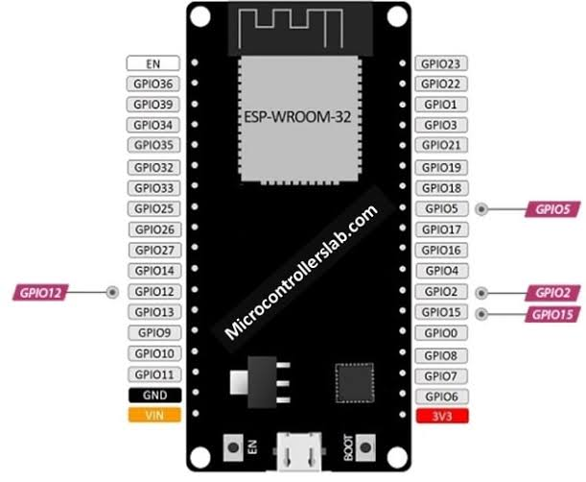
ESP32
The ESP32, a versatile microcontroller, collects air quality data from sensors such as PM and gas sensors. It measures particulate matter (PM2.5 and PM10), CO, CO2, NO2, and SO2 levels. Data is processed and sent to the cloud for analysis, and results can be visualized through web or mobile apps. Calibrating and maintaining sensors are critical for accurate air quality monitoring.

Slide 4
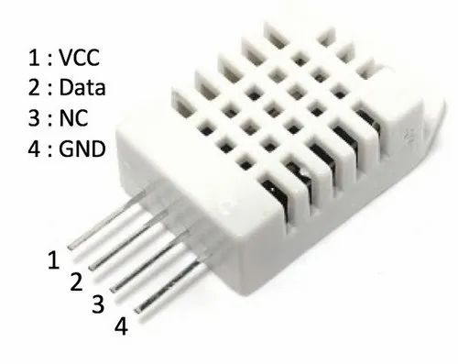
DHT22
The DHT22 sensor, measuring temperature and humidity, is employed in air quality monitoring systems to assess environmental conditions. It helps determine comfort levels and offers valuable data alongside air quality parameters. Integration with microcontrollers like the ESP32 allows for comprehensive monitoring of temperature, humidity, and air quality, enhancing environmental assessments.

Slide 5
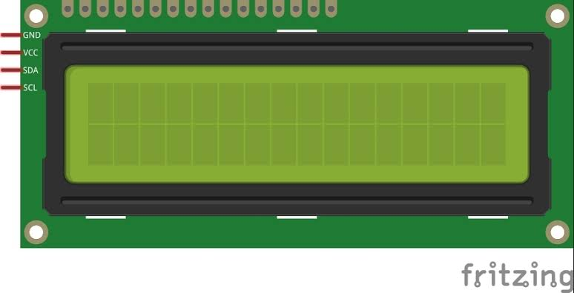
LCD 16X2(12C)
An LCD 16x2 display with I2C communication is integrated into air quality monitoring systems to provide real-time visual feedback on air quality parameters. It shows data from sensors such as PM and gas sensors, making it easier to access information locally. This display enhances user interaction by presenting key air quality metrics, contributing to informed decisions and awareness about the environment's health.

Slide 6
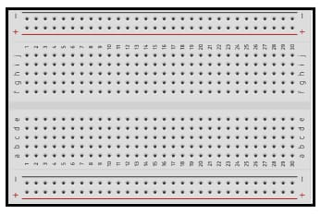
BREADBOARD
Breadboards are vital in air quality monitoring systems for rapid prototyping and assembling electronic circuits. They facilitate the connection of sensors, microcontrollers, and components without soldering, allowing for quick adjustments and experimentation. This flexibility is crucial during the development and testing phases of air quality monitoring devices. Additionally, breadboards simplify the addition or replacement of sensors and components, making them indispensable tools for efficient and iterative system design.

Slide 7


VCC AND GND SYMNOL
VCC (Voltage Supply): This symbol represents the positive voltage supply, typically +5V or +3.3V. It's connected to the red rail on the breadboard and powers components like sensors, microcontrollers, and displays.
GND (Ground): This symbol denotes the ground reference or 0V. It's connected to the blue rail on the breadboard and serves as the common reference point for all components in the circuit. It completes the electrical circuit and ensures proper functioning.

Slide 8
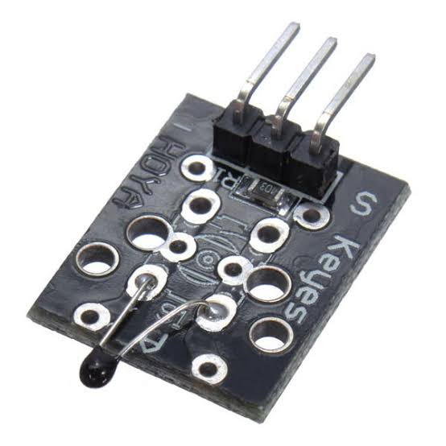
ANALOG TEMPERTURE SENSOR(NTC)
Analog temperature sensors are employed in air quality monitoring systems to measure ambient temperature, which is crucial for assessing environmental conditions. These sensors convert temperature into an analog voltage or current signal that is proportional to the temperature. This analog output is then processed by microcontrollers like the ESP32, facilitating the collection of precise temperature data alongside air quality parameters. By combining temperature measurements with air quality data, these sensors contribute to a more comprehensive understanding of the environment's health and comfort levels.

Slide 9
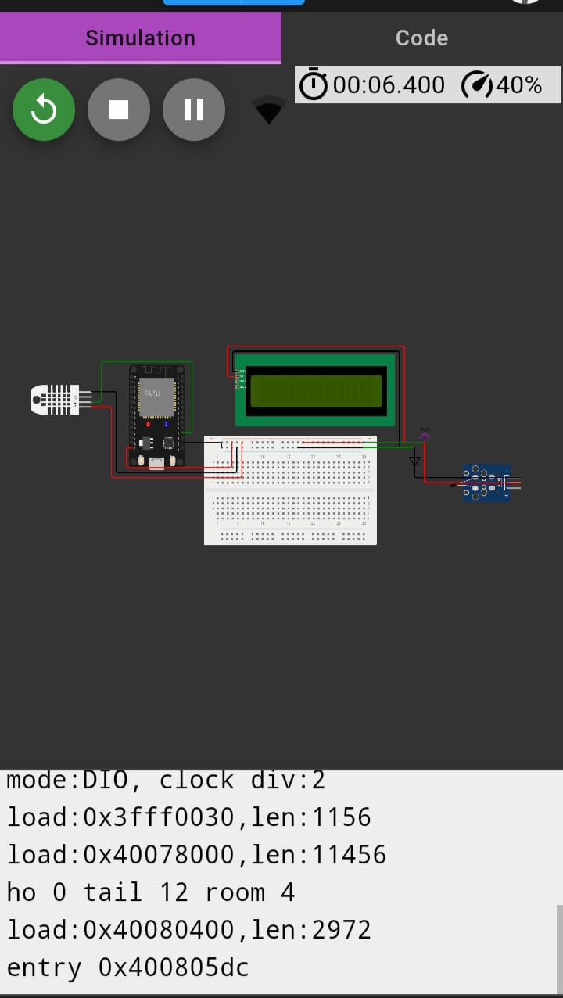
CONNECTION DIAGRAM

